Slide 1
Chapter 10
E-Commerce Security

Slide 2
Learning Objectives
Explain EC-related crimes and why they cannot be stopped.
Describe an EC security strategy and why a life cycle approach is needed.
Describe the information assurance security principles.
Describe EC security issues from the perspective of customers and e-businesses.
Identify the major EC security threats, vulnerabilities, and risks.
Chapter 10

Slide 3
Learning Objectives
Identify and describe common EC threats and attacks.
Identify and assess major technologies and methods for securing EC communications.
Identify and assess major technologies for information assurance and protection of EC networks.
Describe types of fraud on the Internet and how to protect against it.
Chapter 10

Slide 4
Stopping E-Commerce Crimes
Six major reasons why is it difficult for
e-tailers to stop cyber criminals and fraudsters:
  Strong EC security makes online shopping inconvenient for customers
  Lack of cooperation from credit card issuers and foreign ISPs (incentives are not sufficient for credit card issuers to share leads on criminal activity with each other or law enforcement)
  Online shoppers do not take necessary precautions to avoid becoming a victim
  IS design and security architecture are vulnerable to attack
  Software vulnerabilities (bugs) are a huge security problem
  Managers sometimes ignore due standards of care
Chapter 10

Slide 5
Computer Security Classifications
  Secrecy(保密)
  -Protecting against unauthorized data disclosure and ensuring the authenticity of a data source
  Integrity(完整)
  -Refers to preventing unauthorized data modification
  Necessity(即需性)
  -Refers to preventing data delays or denials (removal)

Slide 6
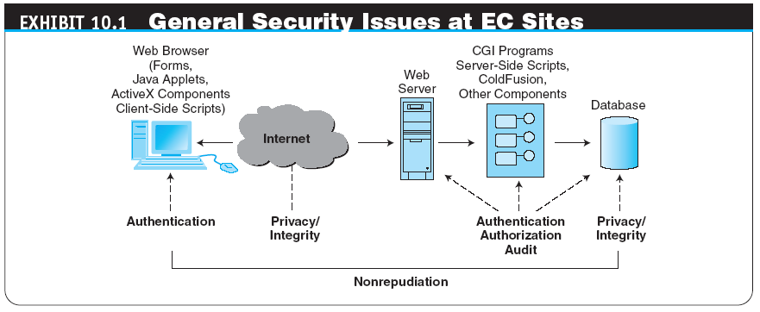
Stopping E-Commerce Crimes
身份认证
授权
不可抵赖
Chapter 10

Slide 7
Stopping E-Commerce Crimes
  due care
  Care that a company is reasonably expected to take based on the risks affecting its EC business and online transactions.
Chapter 10

Slide 8
E-Commerce Security Strategy and Life Cycle Approach
THE INTERNET’S VULNERABLE DESIGN
- The Internet was designed to accommodate computer-to-computer communications in a closed, trustworthy community. The Internet was designed for maximum efficiency without regard for security or integrity (or malicious intent) of a person sending a message or requesting access
THE SHIFT TO PROFIT-MOTIVATED CRIMES
- Criminals and criminal gangs are now profit oriented, and their tactics are not limited to the online world
Chapter 10

Slide 9
Information Assurance
information assurance (IA)
The protection of information systems against unauthorized access to or modification of information whether in storage, processing, or transit, and against the denial of service to authorized users, including those measures necessary to detect, document, and counter such threats.
Chapter 10

Slide 10
Information Assurance
confidentiality
Assurance of data privacy and accuracy. Keeping private or sensitive information from being disclosed to unauthorized individuals, entities, or processes. (See next slide for Exhibit 10.2 on p. 402 for encryption components)
integrity
Assurance that stored data has not been modified without authorization; and a message that was sent is the same message that was received.
availability
Assurance that access to data, the Web site, or other EC data service is timely, available, reliable, and restricted to authorized users.
Chapter 10

Slide 11
Information Assurance
authentication
Process to verify (assure) the real identity of an individual, computer, computer program, or EC Web site.
authorization
Process of determining what the authenticated entity is allowed to access and what operations it is allowed to perform.
Chapter 10

Slide 12
Information Assurance
nonrepudiation
Assurance that an online customer or trading partner cannot falsely deny (repudiate) their purchase or transaction.
digital signature or digital certificate
Validates the sender and time stamp of a transaction so it cannot later be claimed that the transaction was unauthorized or invalid.
Chapter 10

Slide 13
Encryption Solutions
  Encryption(加密)
    -Using a mathematically based program and a secret key to produce a string of characters that is unintelligible
  Cryptography (加密法)
    -Science that studies encryption

Slide 14
Asymmetric Encryption & Symmetric Encryption
    Asymmetric Encryption
      Encodes messages by using two mathematically related numeric keys
      Public key -Freely distributed to the public at large
      Private key -Belongs to the key owner, who keeps the key secret
  Symmetric Encryption
    Encodes message with one of several available algorithms that use a single numeric key

Slide 15
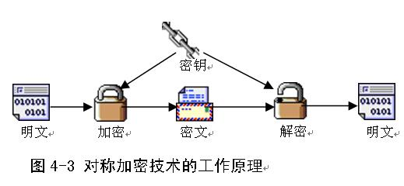
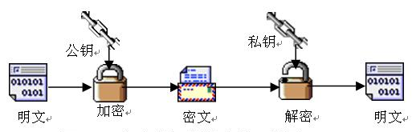

Slide 16
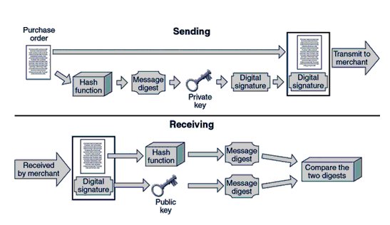
Ensuring Transaction Integrity with Digital Signatures

Slide 17
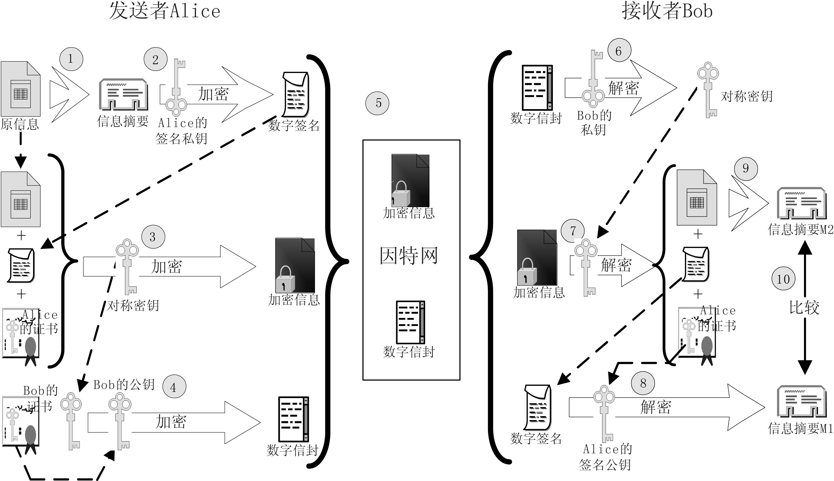

Slide 18
Enterprisewide E-Commerce Security and Privacy Model
EC security program
Set of controls over security processes to protect organizational assets
All the policies, procedures, documents, standards, hardware, software, training, and personnel that work together to protect information, the ability to conduct business, and other assets.
Chapter 10

Slide 19
Basic E-Commerce Security Issues and Perspectives
From the user’s perspective:
  How can the user know whether the Web server is owned and operated by a legitimate company?
  How does the user know that the Web page and form have not been compromised by spyware or other malicious code?
  How does the user know that an employee will not intercept and misuse the information?
From the company’s perspective:
  How does the company know the user will not attempt to break into the Web server or alter the pages and content at the site?
Chapter 10

Slide 20
Basic E-Commerce Security Issues and Perspectives
From both parties’ perspectives:
  How do both parties know that the network connection is free from eavesdropping by a third party “listening” on the line?
  How do they know that the information sent back and forth between the server and the user’s browser has not been altered?
Chapter 10

Slide 21
Securing
E-Commerce Communications
access control
Mechanism that determines who can legitimately use a network resource.
  biometric systems
  Authentication systems that identify a person by measurement of a biological characteristic, such as fingerprints, iris (eye) patterns, facial features, or voice.
Chapter 10

Slide 22
Securing
E-Commerce Networks (Security Design Concepts)
policy of least privilege (POLP)
Policy of blocking access to network resources unless access is required to conduct business.
Defense in depth
- layers of security technologies must be applied at key points in a network (See next slide)
Chapter 10

Slide 23
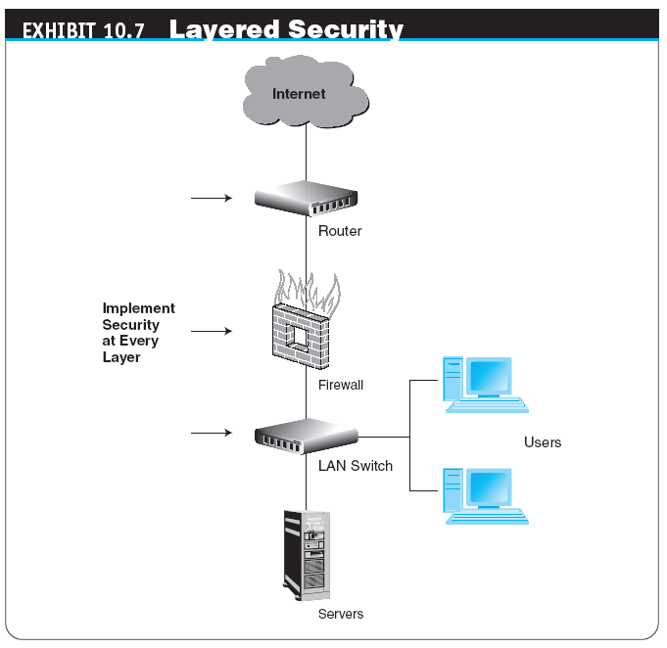
Securing
E-Commerce Networks
Chapter 10

Slide 24
Securing
E-Commerce Networks (Security Design Concepts) continued
Role-specific security
access to particular network resources should be based on a user’s role within an organization.
Monitoring
real-time monitoring has become essential because of zero-day exploits and emerging hacker threats
Patch management
install patch or updates regularly and timely
Incident response team
have a team in place that can respond to attacks
Chapter 10

Slide 25
Securing
E-Commerce Networks
firewall
A single point between two or more networks where all traffic must pass (choke point); the device authenticates, controls, and logs all traffic.
  - packet
  - packet-filtering routers (firewalls that filter data and requests moving from the public Internet to a private network based on the network addresses of the computer sending or receiving the request)
  - packet filters (rules that can accept or reject incoming packets based on source and destination address and other identifying information)
  - application-level proxy
Chapter 10

Slide 26
Securing
E-Commerce Networks
virtual private network (VPN)
A network that uses the public Internet to carry information but remains private by using encryption to scramble the communications, authentication to ensure that information has not been tampered with, and access control to verify the identity of anyone using the network.
intrusion detection systems (IDSs)
A special category of software that can monitor activity across a network or on a host computer, watch for suspicious activity, and take automated action based on what it sees.
Chapter 10

Slide 27
Managerial Issues
Why should managers learn about EC security?
Why is an EC security strategy and life cycle approach needed?
How should managers view EC security issues?
What is the key to establishing strong e-commerce security?
What steps should businesses follow in establishing a security plan?
Should organizations be concerned with internal security threats?
Chapter 10

Slide 28
Summary
Stopping e-commerce crimes.
EC security strategy and life cycle approach.
Information assurance.
Enterprisewide EC security and privacy model.
Basic EC security issues and perspectives.
Chapter 10

Slide 29
Summary
Threats and attacks.
Securing EC communications.
Technologies for securing networks.
Fraud on the Internet and how to protect against it.
Chapter 10

